Slide 1
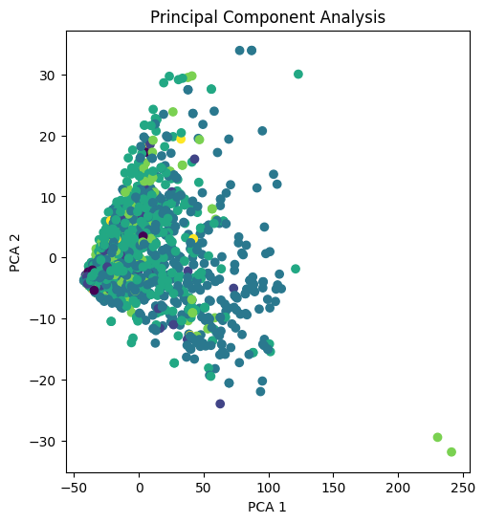
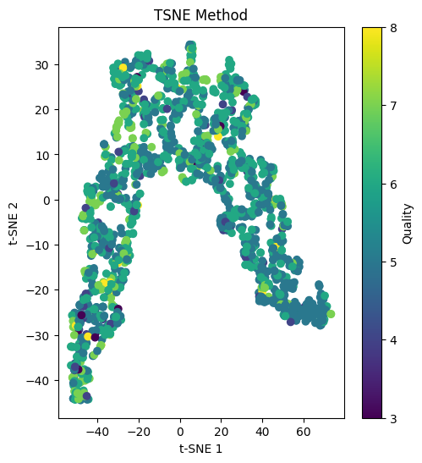
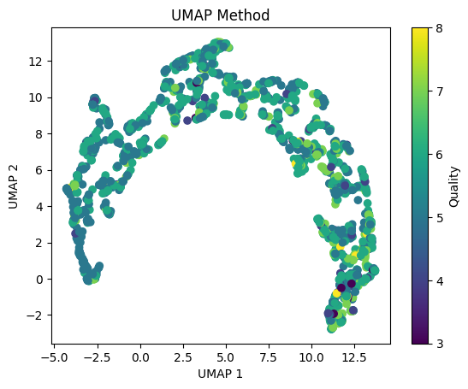
I have assumed the notation that ‘quality’ = 3 is bad quality wine and ‘quality’ = 8 is good quality wine.
My hypotheses are as follows:
H0: There is no difference in the fixed acidity content between the good and bad quality wine.
H1: There is a difference in the fixed acidity content between the good and bad quality wine.
Furthermore, I am using the ttest metric to check if the fixed acidity content contributes significantly to the quality of the wine. This is because of my assumption stated above that divides the entire feature into two groups, which is the necessary condition to perform the ttesst.
My results are as follows:
t-statistic: -0.261240315524843
p-value: 0.7959654556020868
Thus, we see that the p-value is over the nominal value of 0.05 and hence we fail to reject the null hypothesis. Thus, the observed data is consistent with the null hypothesis. We don’t have enough evidence to reject it based on the null hypothesis.
Alap Mundayoor, M.N. 23351429, IdM: ow07ysym

